Slide 1

Generation of predictions of weight and illness in cattle
Student : Manuela Zapata
Advisors: Mauricio Toro
Rodrigo García
José Aguilar
Mathematical Engineering
Department of Mathematical Sciences
School of Sciences
Universidad EAFIT

Slide 2


Objectives of the Project
•Formulate and apply correctly mathematical models to predict weight and illness in the cattle using simulated historical data.
• Formulate mathematical models that will be applied to Machine Learning algorithms that can make predictions of the weight and illness of the cattle.

Slide 3

Data simulation
Extense literarture review: Normal distribution
Weisstein, E. W. (2002)

Slide 4
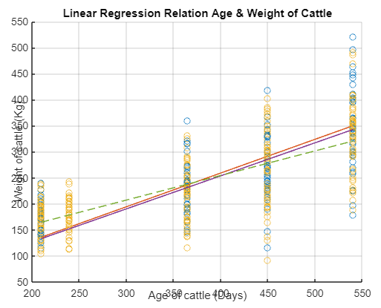
Data simulation

Slide 5


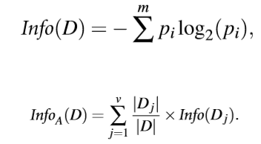
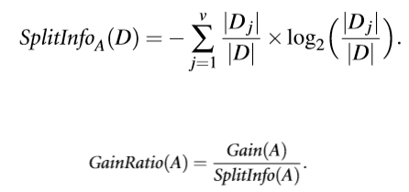





Machine Learning Algorithms
Random Forest Regressor
Decision Tree Regressor
XGBoost
Support Vector Machine (SVM)
(SVM), 2021)
(Python & Vidhya, 2021)
(Yale, 2021)

Slide 6

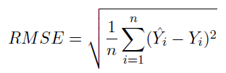

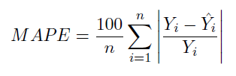
Statistical Metrics
Mean Square Error (MSE)
Root Mean Square Error (RMSE)
R^2
Mean Absolute Percentage Error (MAPE )
(Gölcü et al., 2005)

Slide 7
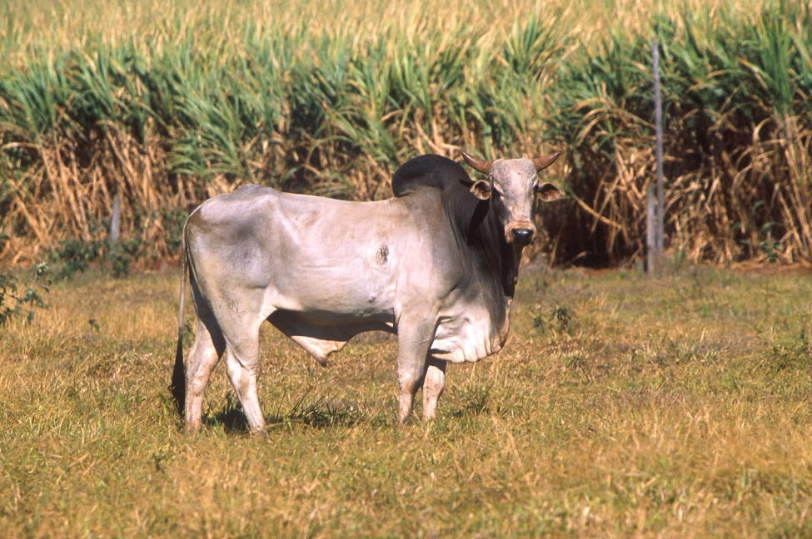
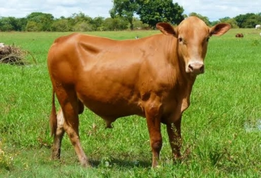
Animal Breeds
Cebú
Romosinuano (ROMO)
(Wikipedia, 2021)

Slide 8
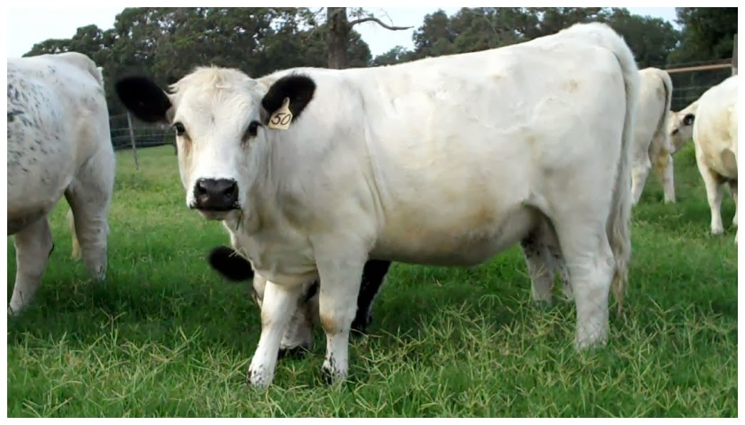
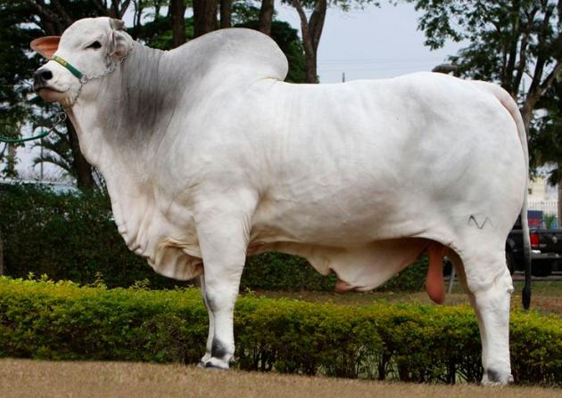
Animal Breeds
Blanco Orejinegro (BON)
Nellore
Generalidades de la ganadería bovina (2014)

Slide 9
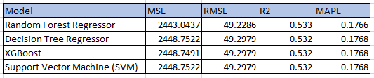
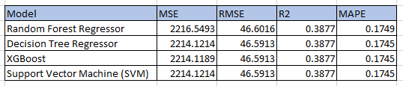
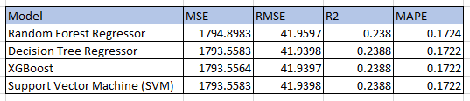
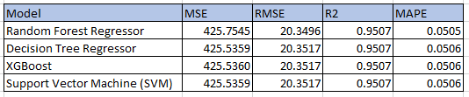
Results
Cebú:
BON
ROMO:
Nellore:

Slide 10
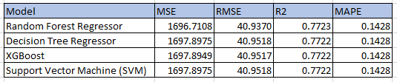
Results
All breeds:

Slide 11
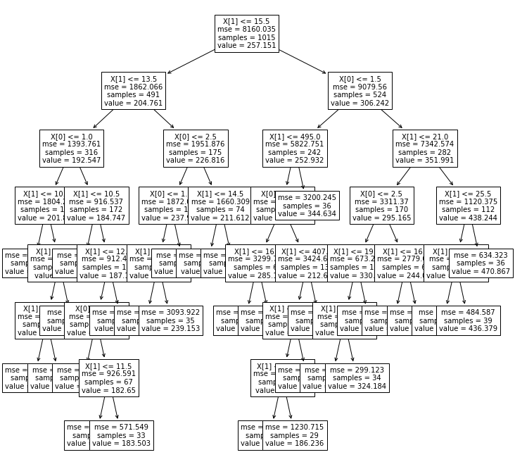
Results

Slide 12
Conclusions
Important source of error: Artificial data and not a high volume of data.
Similarity on the data due to normal distribution.
Slightly better outcome on Random Forest Regressor due to bootstrap aggregation method.
For future research: Higher volume of data and usage of not simulate data.
The usage of other variables such as weather, purpose of the animal (milk, meat), grass they are fed with.

Slide 13
Bibliography
Gölcü, M., Sekmen, Y., Erduranlı, P., & Salman, M. S. (2005). Artificial neural-network based modeling of variable valve-timing in a spark-ignition engine. Applied Energy, 81(2), 187-197.
(SVM), T. (2021). Mathematics Behind SVM | Math Behind Support Vector Machine. Retrieved from https://www.analyticsvidhya.com/blog/2020/10/the-mathematics-behind-svm/
Linear Regression. (2021). Retrieved from http://www.stat.yale.edu/Courses/1997-98/101/linreg.htm
Python, S., & Vidhya, A. (2021). Logistic Regression R | Introduction to Logistic Regression. Retrieved from https://www.analyticsvidhya.com/blog/2015/11/beginners-guide-on-logistic-regression-in-r/#:~:text=log(p%2F1%2Dp,association%20in%20a%20linear%20way.&text=This%20
Wackerly, D., Mendenhall, W., & Scheaffer, R. (2010). Estadística matemática con aplicaciones. México: Cengage Learning.
Weisstein, E. W. (2002). Normal distribution. https://mathworld. wolfram. com/.
Wikipedia. (2021). Cebu breed animal [Image]. Retrieved 4 June 2021, from https://es.wikipedia.org/wiki/Bos_primigenius_indicus.}, journal={es.wikipedia.org.

Slide 14


Thank you
Notes:
Grafico con fondo de color

